Slide 1
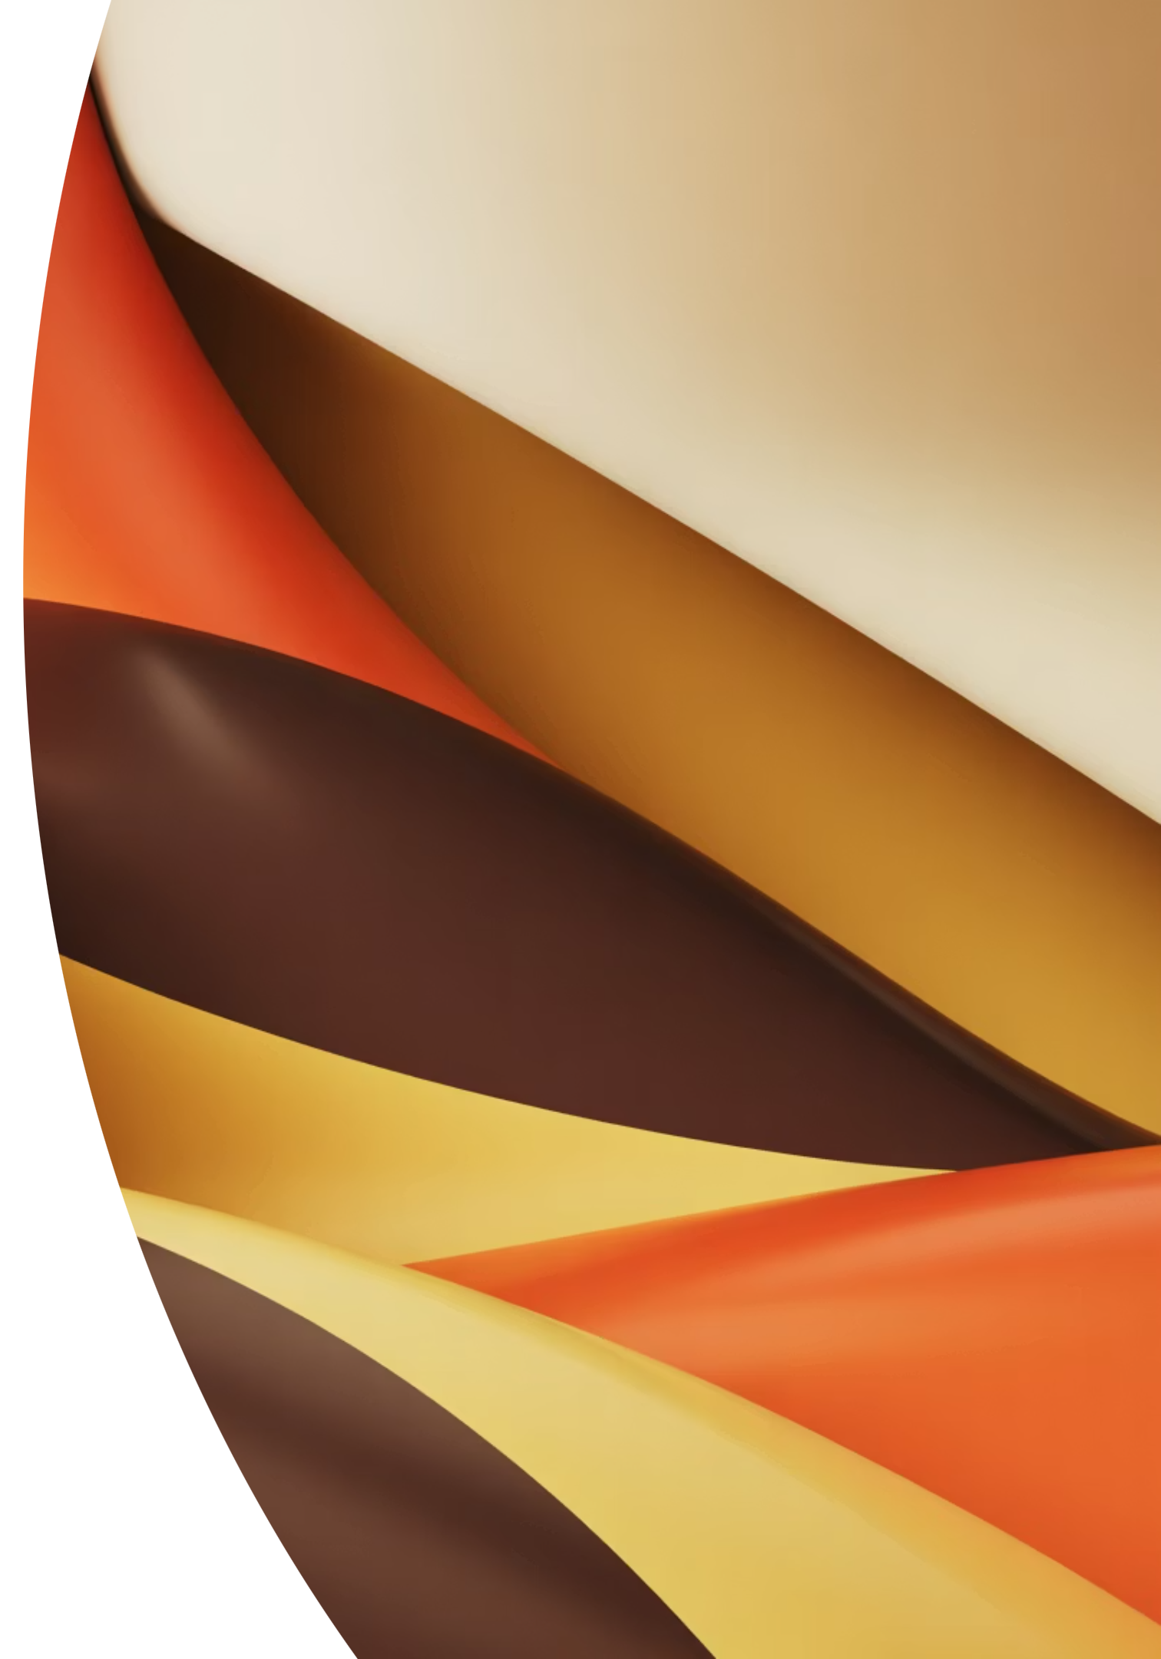
Support Vector Regression
Understanding margin-based regression through intuitive visualization and gentle mathematical foundations

Slide 2
Why Support Vector Regression?
The Challenge
The SVR Solution
Traditional regression methods are sensitive to outliers and noise. They minimize every error equally, which can lead to overfitting on noisy data.
Support Vector Regression introduces a margin-based approach to regression problems. Instead of fitting all points exactly, SVR creates a tolerance zone around the prediction function.
We need a more stable, robust approach that focuses on the general pattern rather than fitting every point.
This margin-focused strategy produces models that generalize better to unseen data.

Slide 3



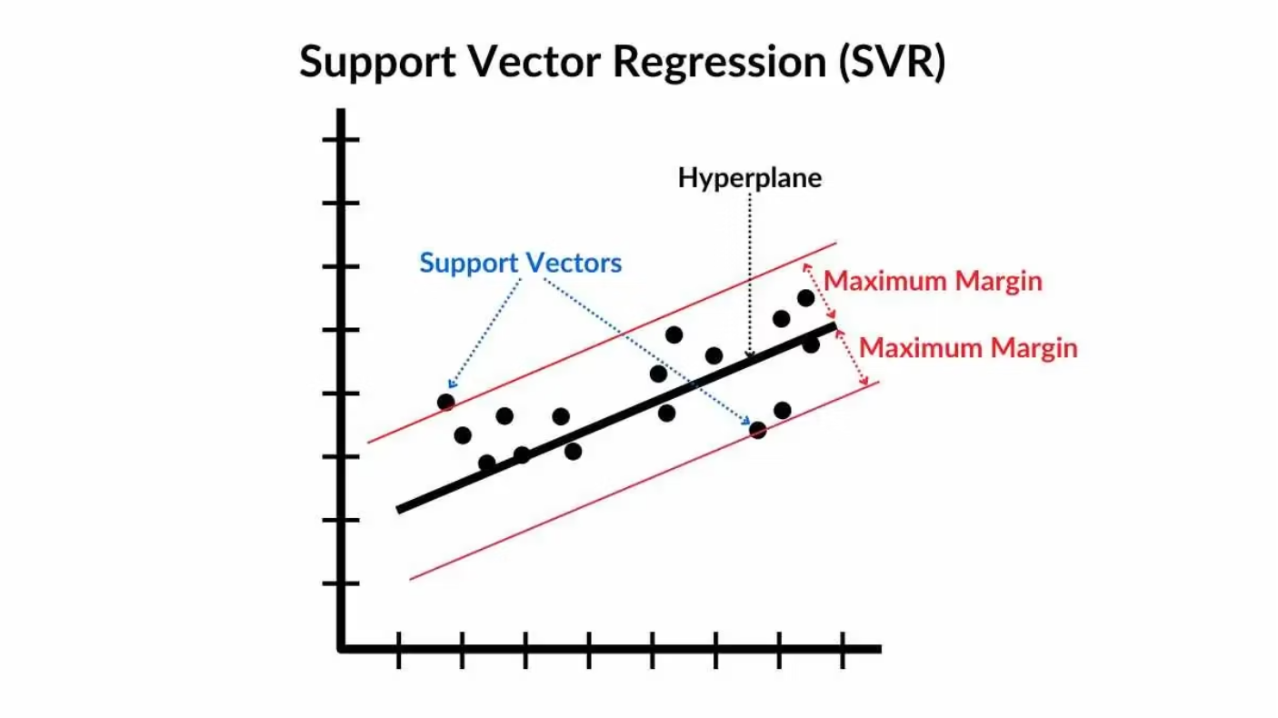
The Epsilon Tube Concept
The Tolerance Zone
Zero Loss Region
Beyond the Margin
SVR constructs an epsilon (ε) tube around the regression function. This tube defines an acceptable margin of error.
Points falling inside the tube contribute zero loss to the model. The model tolerates small deviations without penalty.
Only points outside the tube are penalized. This creates a sparse solution focused on boundary cases.
The epsilon parameter controls the tube width, balancing model complexity against fitting accuracy.

Slide 4
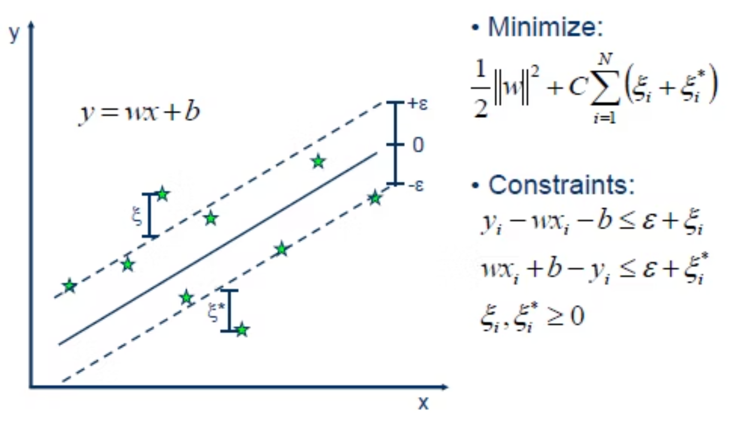
Handling Violations with Slack Variables
Real Data Is Imperfect
In practice, not all points can fit within the epsilon tube. Some observations will inevitably fall outside the margin.
SVR introduces slack variables (ξ) to measure these violations. Each point outside the tube contributes a penalty proportional to its distance from the tube boundary.
This linear penalty creates a balance: the model seeks to minimize tube width while keeping most points inside.
Mathematical Insight: The slack variables ξᵢ and ξᵢ* allow symmetric violations above and below the tube, making SVR robust to various noise patterns.

Slide 5


SVR vs Linear Regression
Linear Regression
Support Vector Regression
Objective: Minimize sum of squared errors
Objective: Maintain epsilon-insensitive margin
Sensitivity: Every point affects the model equally
Sensitivity: Only boundary points matter
Result: Can overfit to outliers and noise
Result: Better generalization and robustness
The margin-based approach of SVR produces models that are less influenced by noise, leading to improved performance on unseen data.

Slide 6
SVR Implementation Workflow
01
02
Scale Features
Choose Kernel
Normalize input data to ensure features contribute equally
Select linear, polynomial, or RBF kernel based on data structure
03
04
Set Epsilon (ε)
Pick Regularization (C)
Define the tube width—larger ε creates simpler models
Balance margin width vs. violation penalties
05
06
Train Model
Predict & Evaluate
Solve the optimization to find support vectors
Apply model to new data and assess performance

